Slide 1

Smile…You are on Camera
Deer Population Estimation - Remote Camera Activity
NC Wildlife Resources Commission

Slide 2

Testing your wildlife ID skills
Notes:
Slides 2- 9 are used to develop critical observation skills and to test students ability to ID animals. Show students a variety of animals captured on remote and to see if they can identify the animals. Point out different traits/patterns and body parts that help with ID.

Slide 3
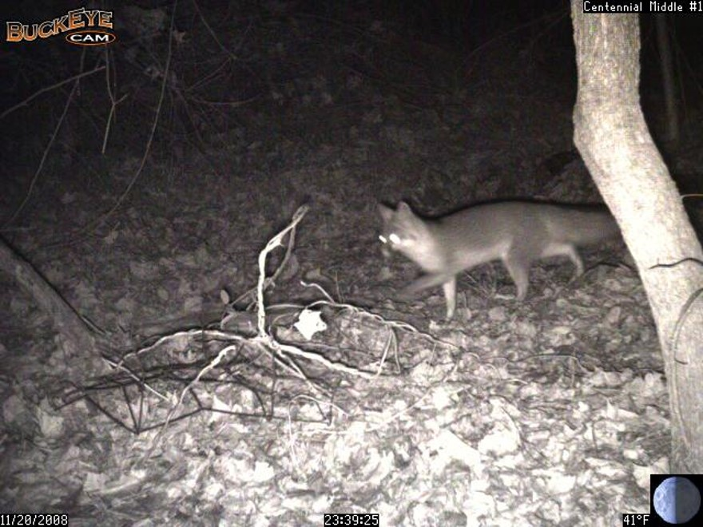
Notes:
Photo: Grey fox or red fox? cannot see its black tipped tail in this slide. Go on to next slide for more detail about animal characteristics to help with ID

Slide 4
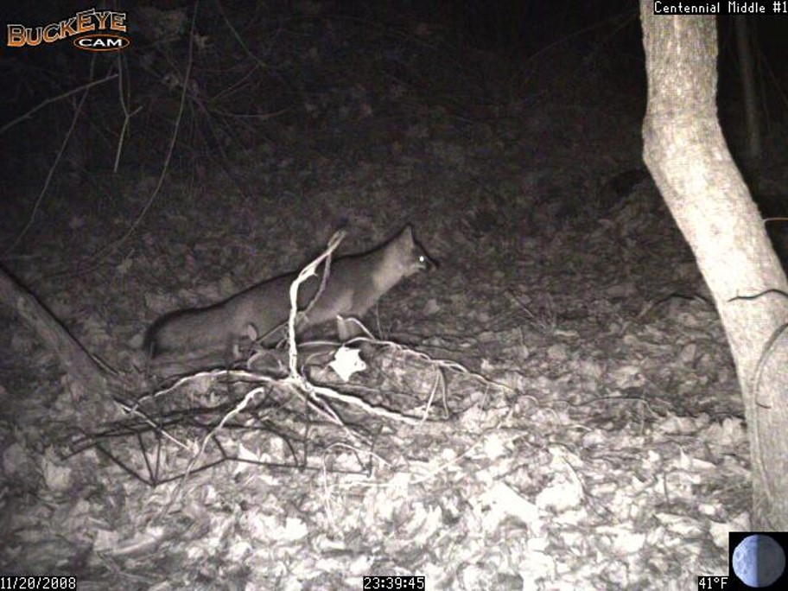
Notes:
Gray fox-identified by black tipped tail
Red fox have white tipped tail

Slide 5
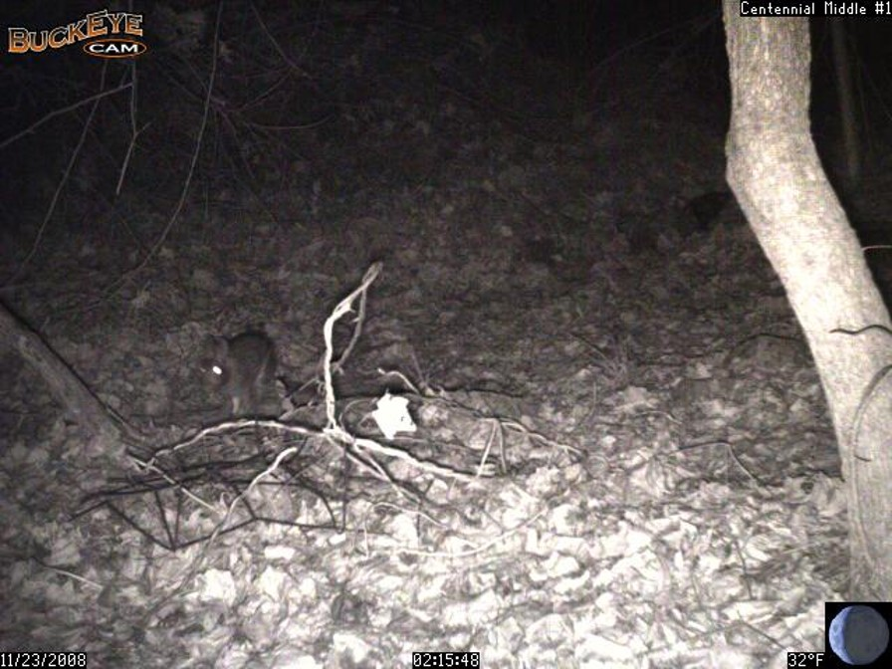
Notes:
Rabbit- head view

Slide 6
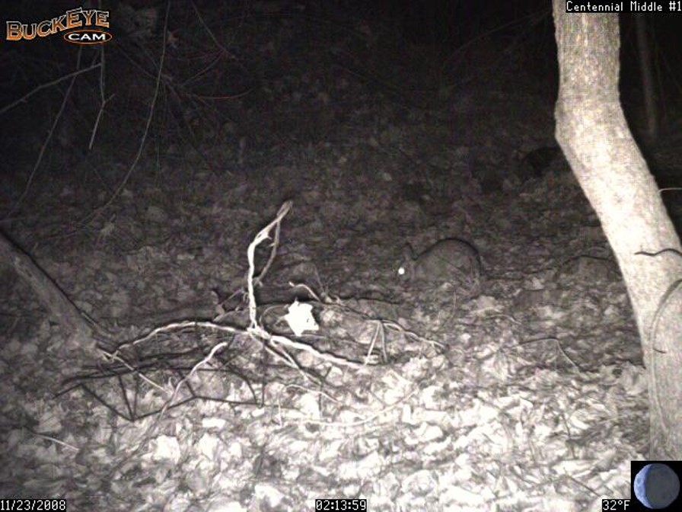
Notes:
Rabbit- side view

Slide 7
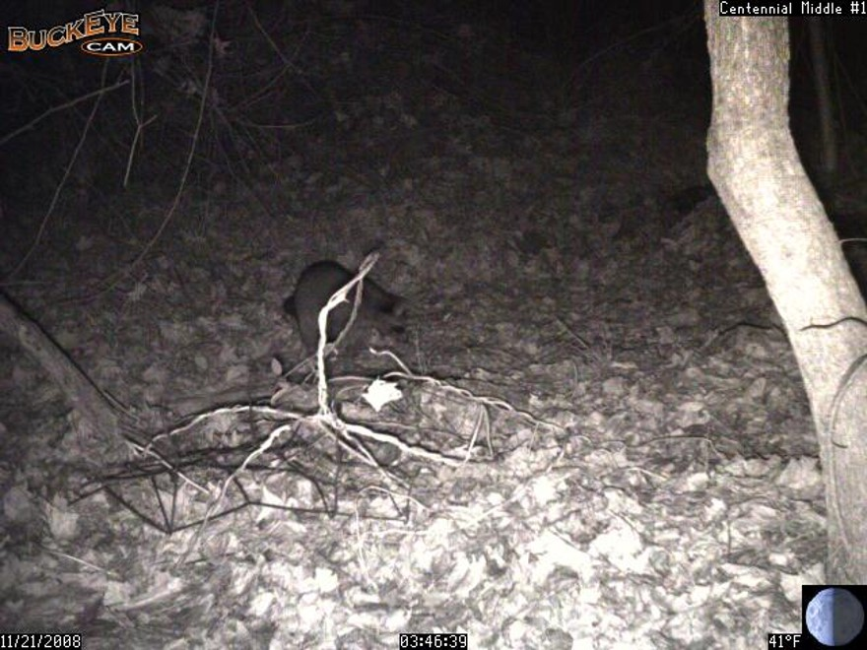
Notes:
Raccoon – body shape, face shape and mask

Slide 8
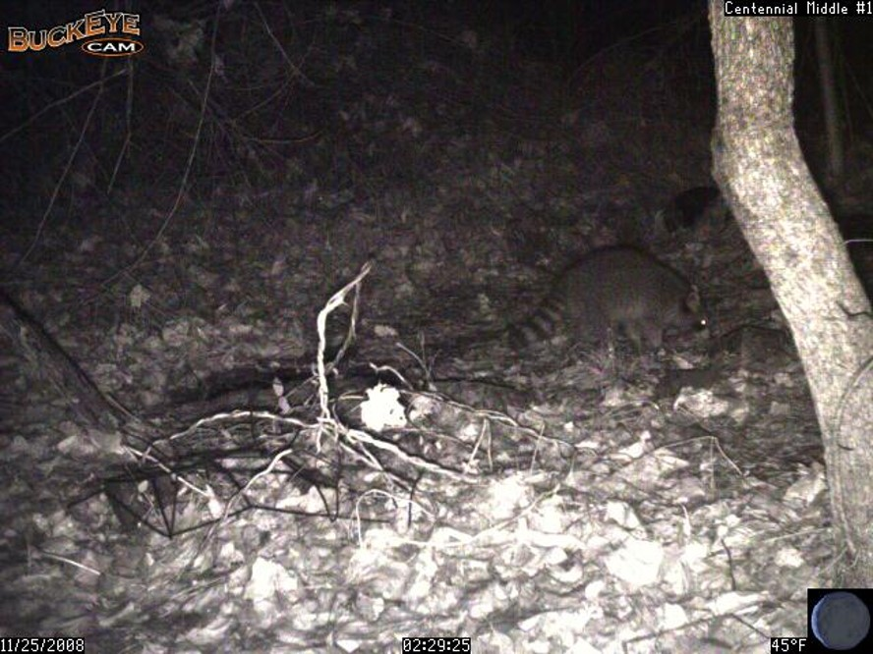
Notes:
Raccoon – characteristic striped tail and body shape

Slide 9
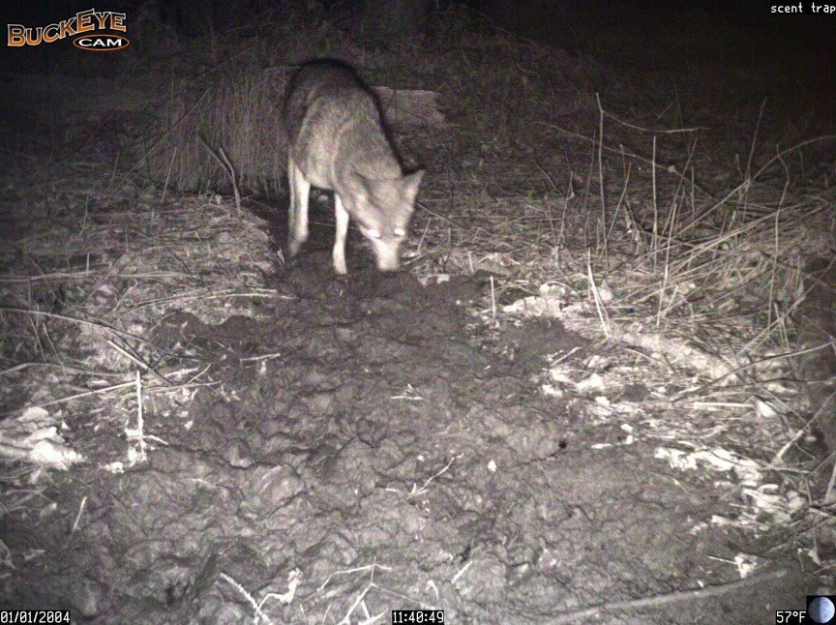
Notes:
Coyote

Slide 10
Estimating a Deer Population

Slide 11
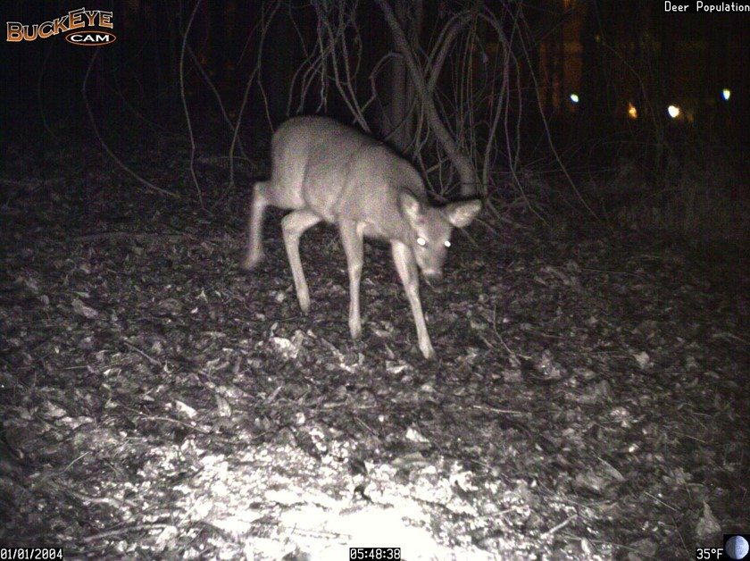
Notes:
Beginning with this slide students count the number of bucks, determine how many are unique bucks and count total deer. See lesson/activity teacher instructions and use Student worksheet.
#bucks #unique bucks # does # fawns/yearling

Slide 12
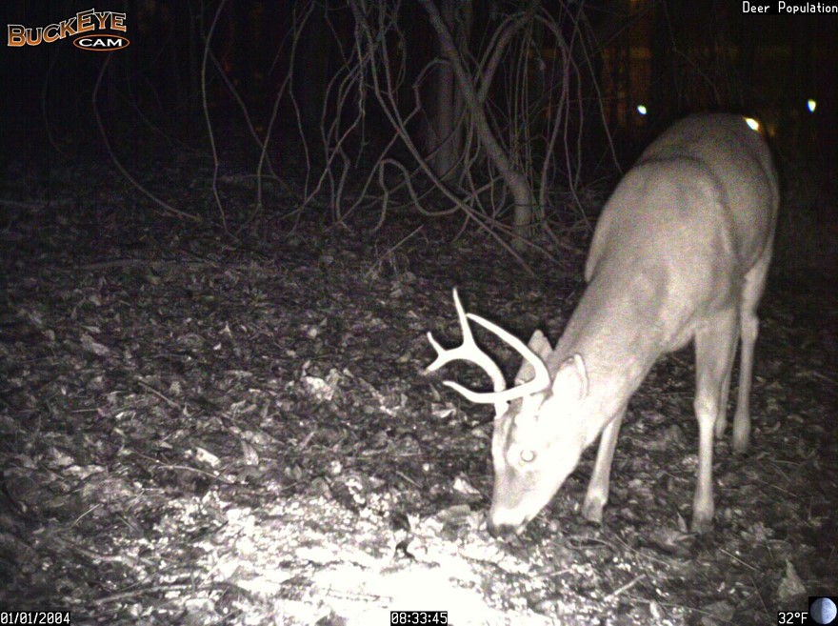

Slide 13
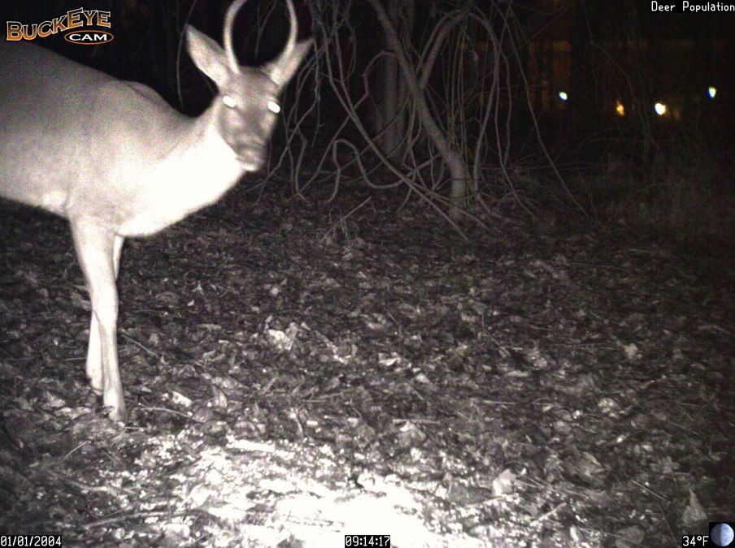

Slide 14
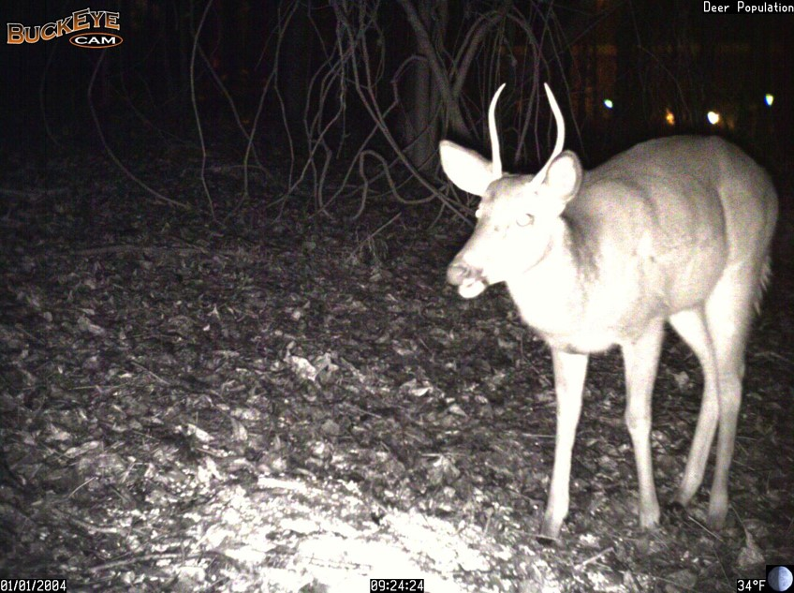

Slide 15
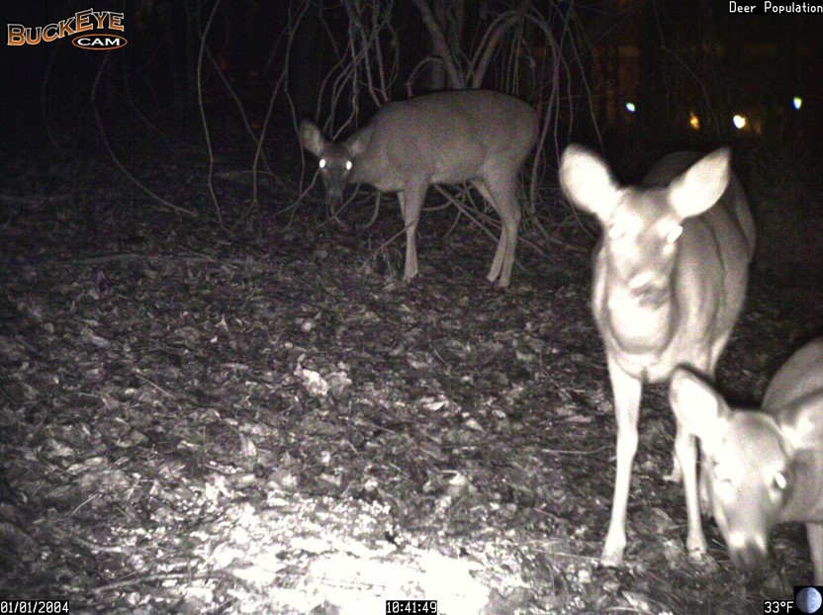

Slide 16
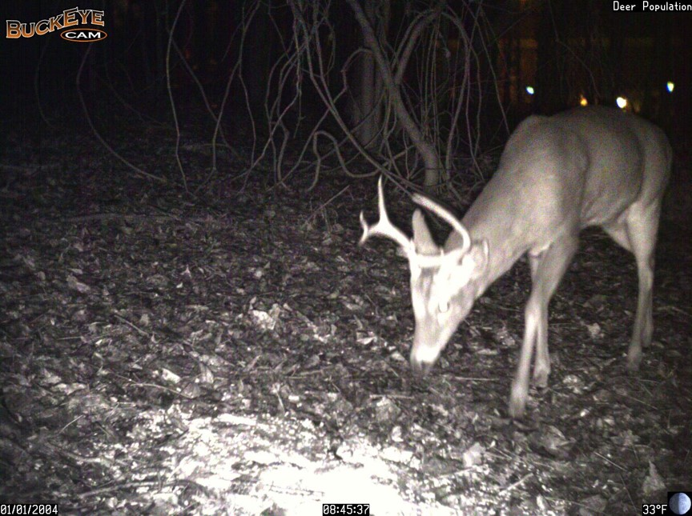

Slide 17
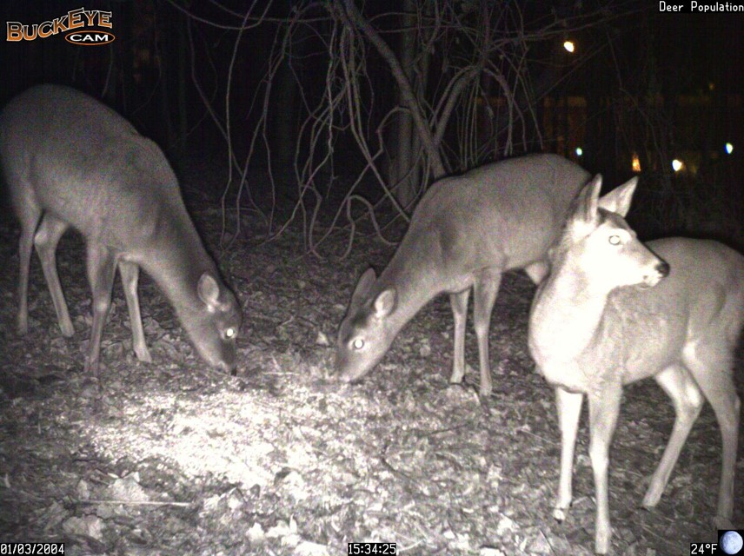

Slide 18
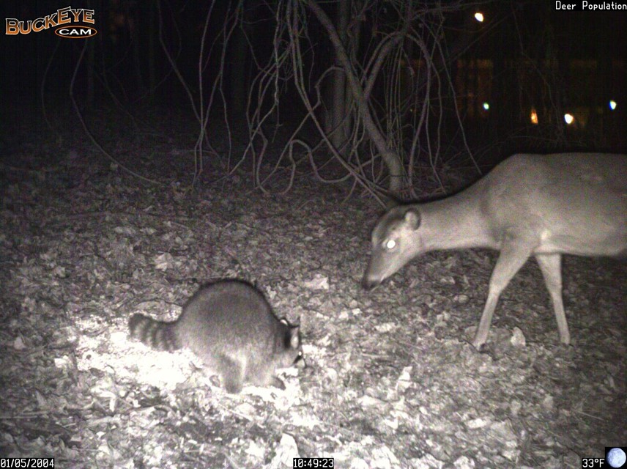

Slide 19
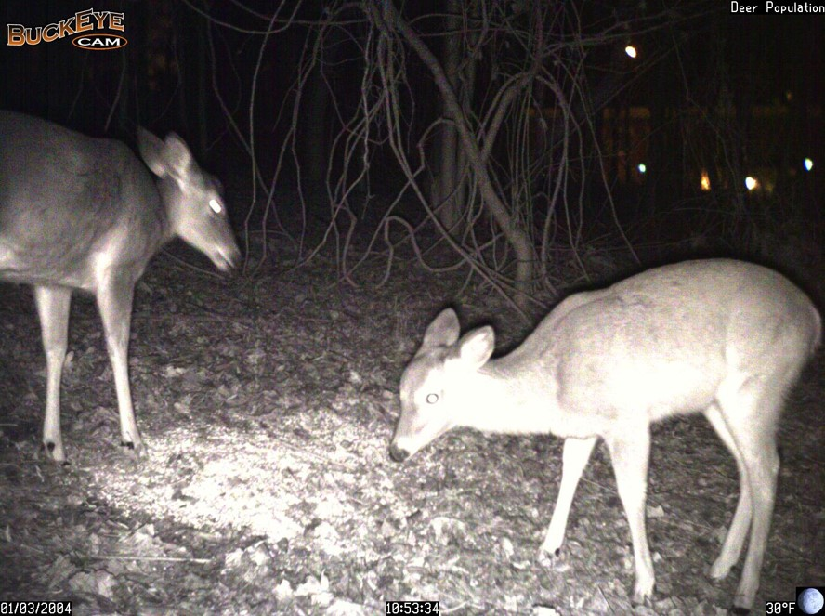

Slide 20
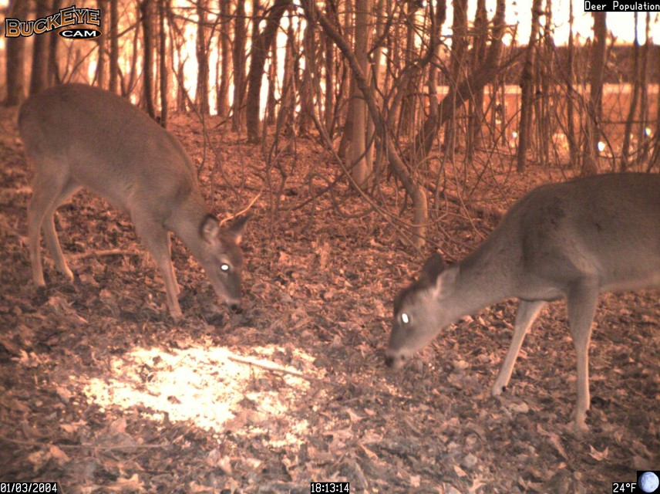
Notes:
Two does. At first glance the deer on the left looks like it has an antler however at close inspection notice what is being seen is a branch or vine.

Slide 21
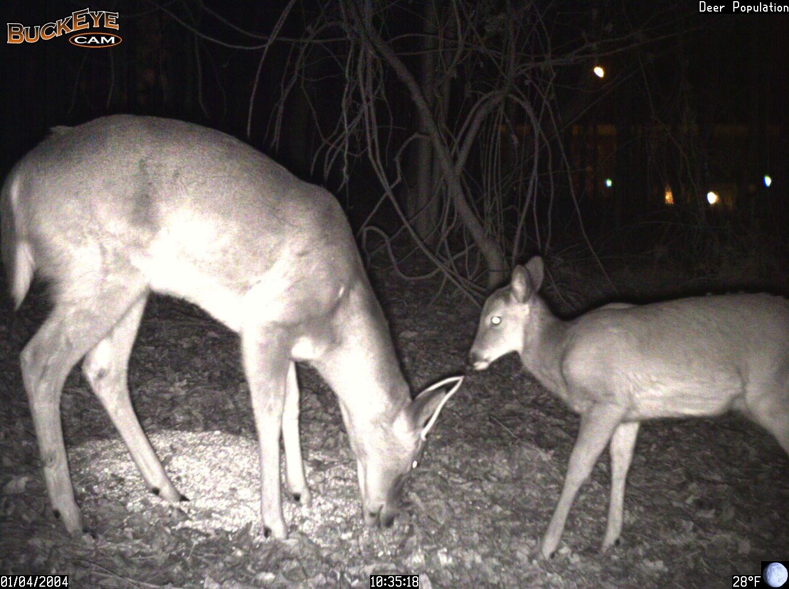

Slide 22
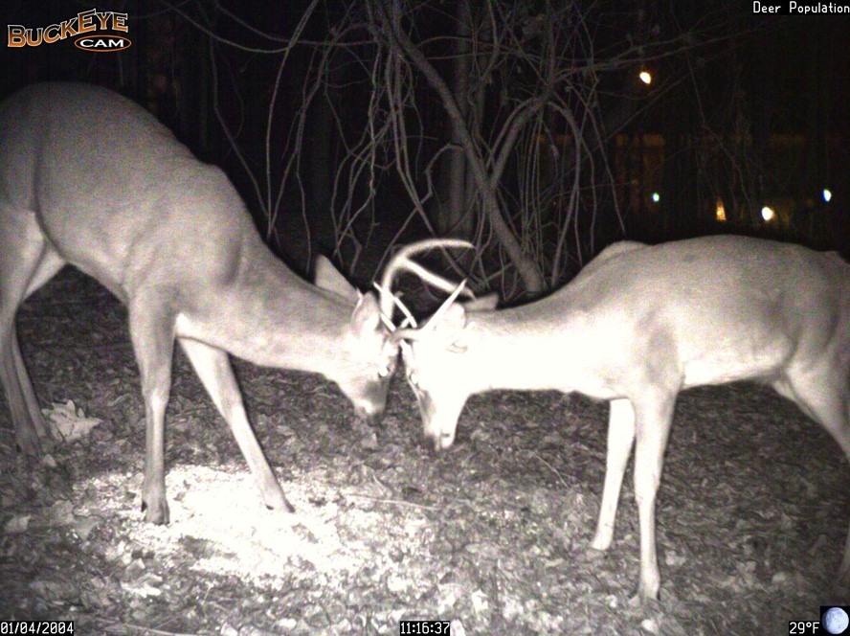

Slide 23
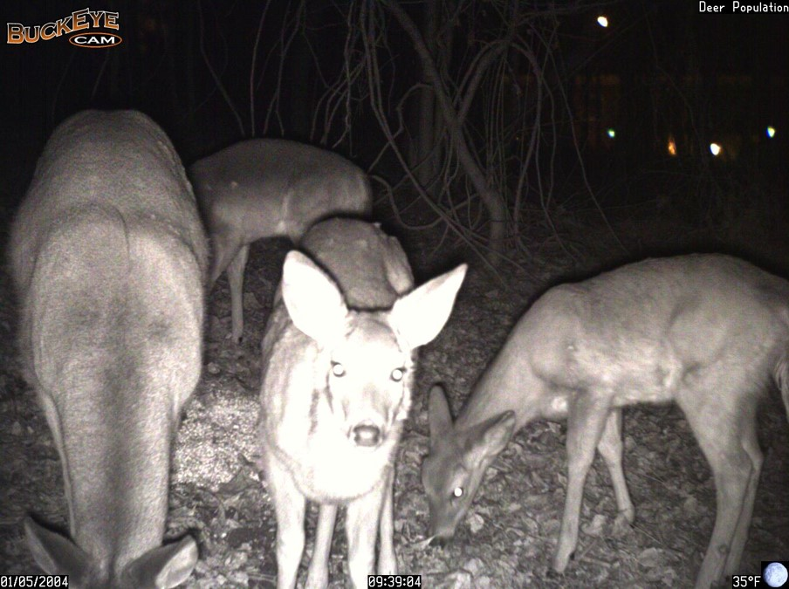

Slide 24
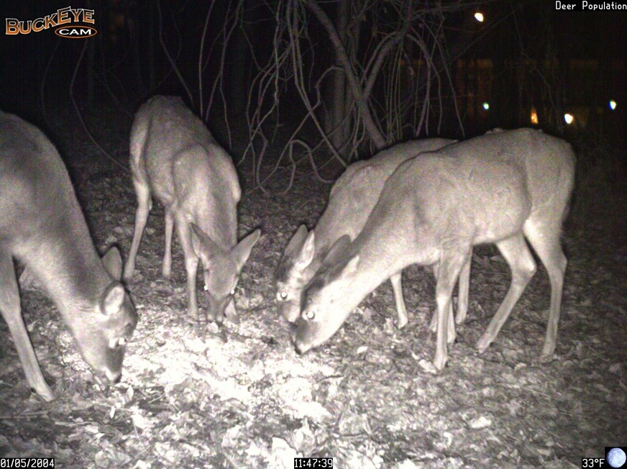

Slide 25
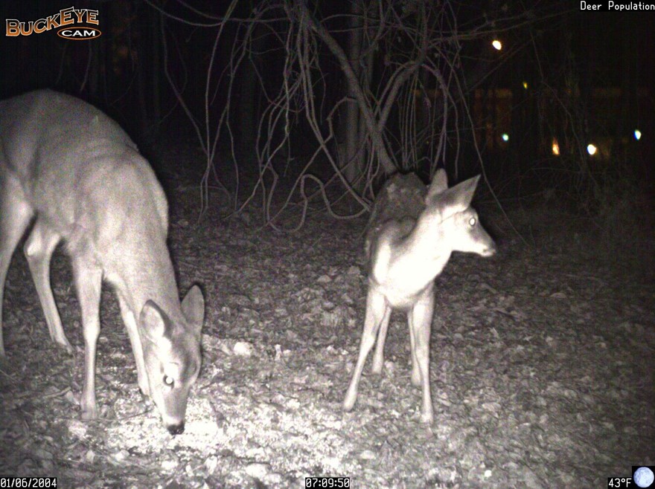

Slide 26
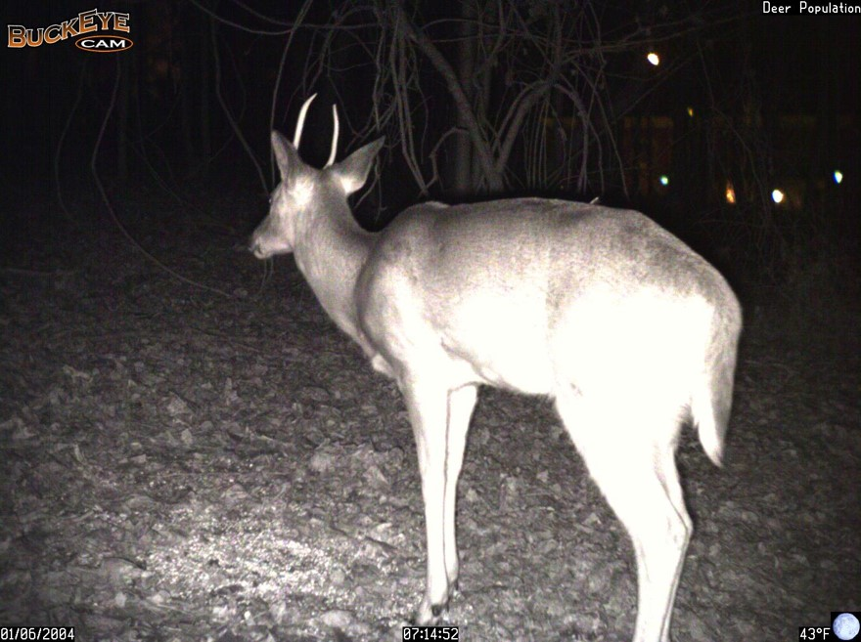

Slide 27
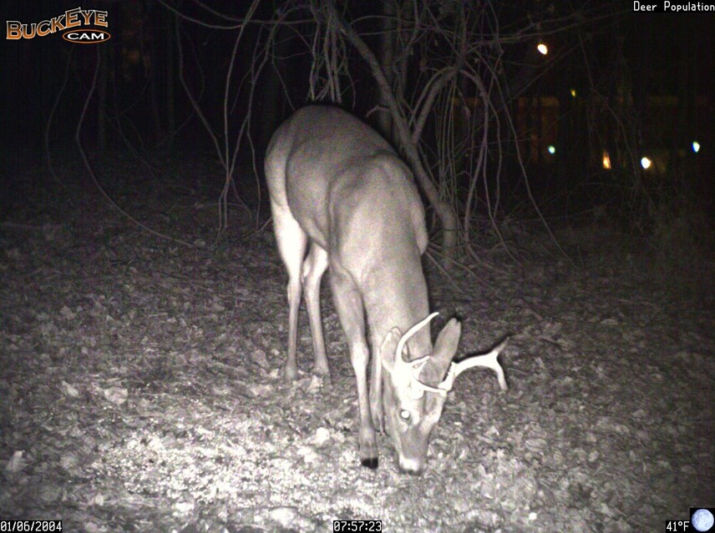
Notes:
End of deer series: at this point ask students how many were observed: Bucks 12 Unique Bucks(2) Doe 18 Fawn 3
If they come up with more than two unique bucks show them the next slide. It is the same buck as in this slide….take home point- must carefully look for distinguishing antler traits.

Slide 28
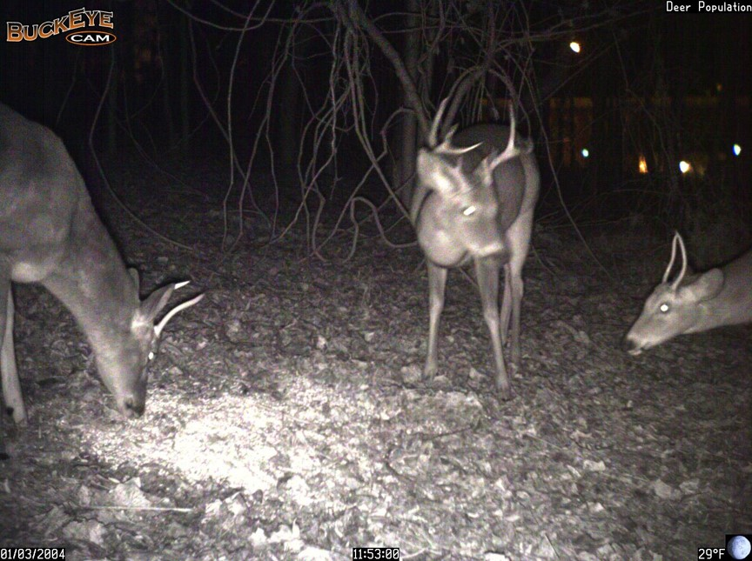
Notes:
Final slide in the series. It is very difficult to tell whether the spike buck is the same buck in all the previous slides. With this slide it is obvious there are two spike bucks in the population.
Bucks = 12 Unique bucks = 3 Does = 18 Fawns = 3
Total deer by category: bucks 12 (unique bucks 3) does 18 fawn 3
See student worksheet for calculations and use teacher answer sheet as a reference.

